Slide 1
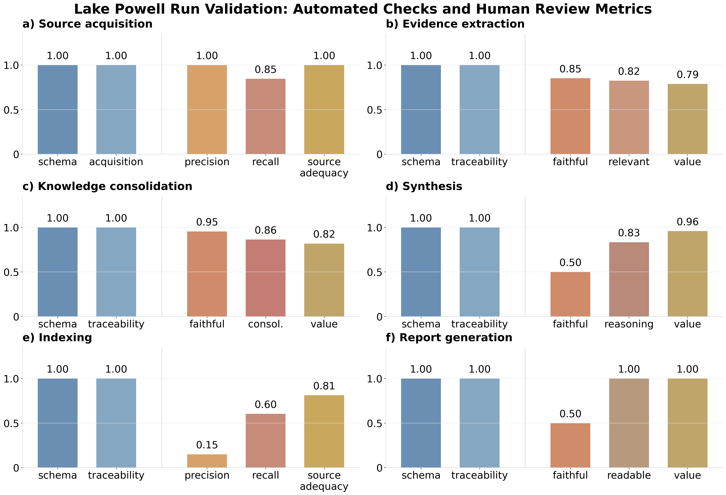







A. Background: From Information to Scientific Discovery
B. Our Contribution: Evidence-Traceable Scientific Knowledge Construction
Level 3
Scientific Discovery
Formulate new questions,
Develop hypotheses,
And generate insights
Future Goal
Agentic AI as a collaborator that accelerates scientific discovery
Source acquisition
sᵢ: the i-th source;
n: total number of sources
S_A: official & operational
S_B: scientific & research
S_C: public context
b) Evidence extraction
Extract validated, source-grounded findings from individual documents.
i : source index
j : knowledge topic
m : synthesis card
$$𝒮={\left\{s_{i}\right\}}_{i=1}^{n}$$
$$𝒮=𝒮_{A}∪𝒮_{B}∪𝒮_{C}$$
$$e_{ij}=f_{ext}\left(s_{i}\right)$$
Current Focus
Build evidence-traceable
scientific knowledge
that is reliable, and reusable
$$e_{ij}=\left\{c_{ij},q_{ij},l_{ij},s_{i}\right\}$$
Level 2
Knowledge Construction
Integrate evidence across sources, organize into coherent knowledge, and produce traceable syntheses
c) Knowledge consolidation
d) Synthesis
Level 1
Information Processing
Read, extract, and organize from individual documents and build searchable indexes
Well Developed
Strong at retrieving, extracting, and organizing information at scale
$$𝒦_{m}=\left\{K_{j}∈𝒦∣K_{j}∼m\right\}$$
$$K_{j}=\left\{e_{i}:\operatorname{topic}\left(e_{i}\right)=j\right\}$$
$$S_{m}=f_{syn}\left(𝒦_{m}\right)$$
C. Study Case: Lake Powell as an example
D. Impact: Enabling Human-AI Scientific Discovery
From Syntheses to Scientific Inquiry
SC
?
H
N
T
Synthesis &
Cards
Research
Questions
Hypotheses
New Studies
Scientific
Discovery
Traceable
scientific insights
Identify gaps and
opportunities
Formulate and
prioritize
Design observations,
experiments,
and analyses
New knowledge,
better decisions
AI constructs trustworthy knowledge.
Humans drive discovery.
AI
<->
Human

Slide 2







i 文章，j 提取的主题，m是synthesis的type
$$𝒮={\left\{s_{i}\right\}}_{i=1}^{n}$$
$$e_{ij}=f_{ext}\left(s_{i}\right)$$
$$K_{j}=\left\{e_{i}:\operatorname{topic}\left(e_{i}\right)=j\right\}$$
$$𝒮=𝒮_{A}∪𝒮_{B}∪𝒮_{C}$$
$$e_{ij}=\left\{c_{ij},q_{ij},l_{ij},s_{i}\right\}$$
$$𝒦_{m}=\left\{K_{j}∈𝒦∣K_{j}∼m\right\}$$
$$S_{m}=f_{syn}\left(𝒦_{m}\right)$$
Official Sources
Government agencies
Reservoir operators
Official manuals
Scientific Research
Journal Papers
Technical Report
Research institutes
Public Sources
Public Websites
Community
News

